Slide 1
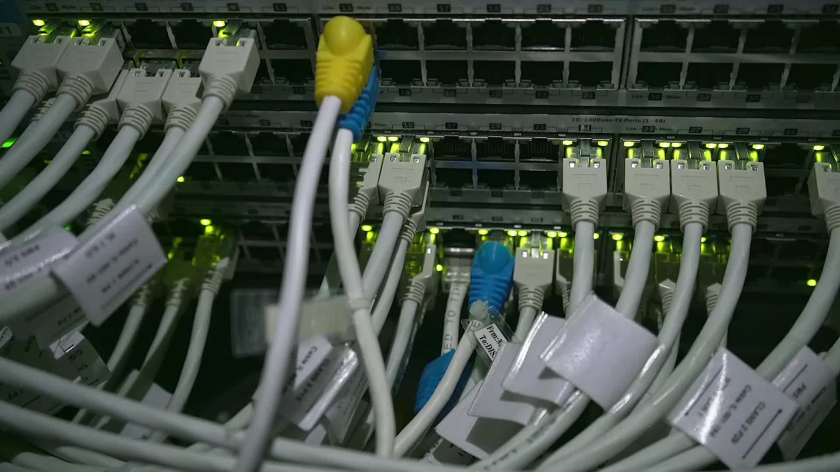
Customer Service Representative’s Software System
Team:
Youssef Mohammed Hasan 20235136
Ahmed Mohammed Imam 20235009
Youssef Kamal 20235135
Yahia Mohammed 20235131

Slide 2
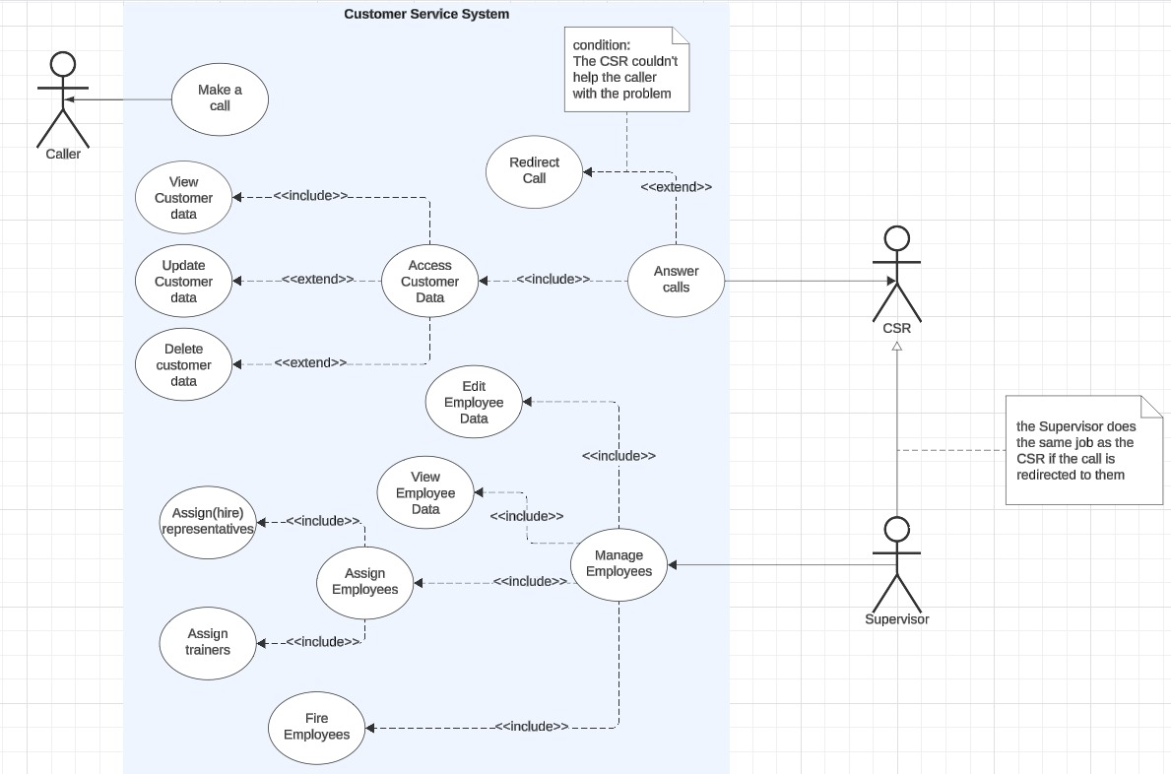
Introduction
The Customer Service Representative’s Software System is used by CSRs and their supervisors to be able to help their customers with there issues and requests as well as making their work easier
There are three major actors in the system:
The representatives:
They are the company’s most important employees
They are the ones that take the calls and fulfill the caller’s demand
The supervisors
They manage the CSRs and assess their performance
They take the calls escalated by the CSRs
The callers
The focus of the CSR’s job

Slide 3
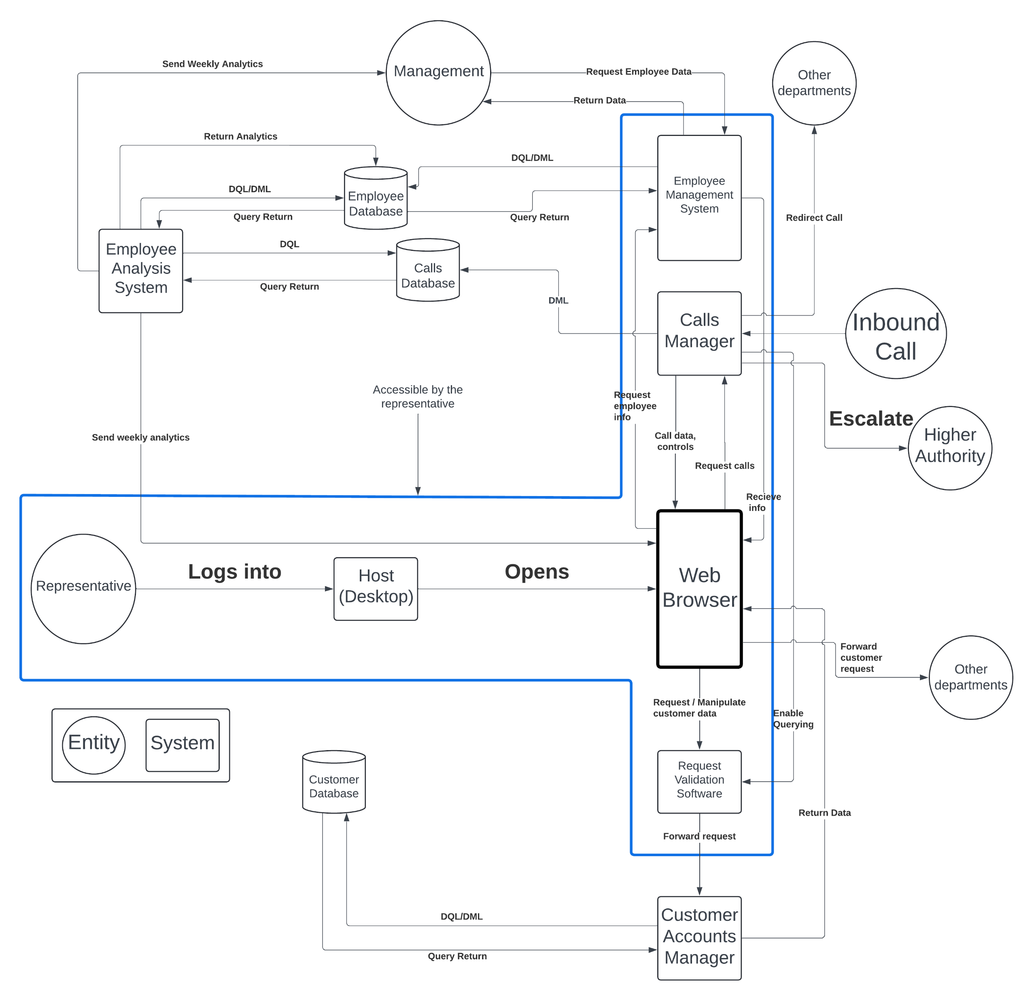
A simple diagram of the system

Slide 4
The System’s Components
The web browser:
An interface for the system
Functional Requirements:
User authentication.
Access to internal systems.
Ability to send requests to the software within the system.
Sending the customer’s request.
Data integrity and synchronization.
Real-time communication and notifications.

Slide 5
The System’s Components
The Calls Manager:
Helps the user receive, accept, redirect, record, and log calls
Functional Requirements
The Calls Manager must be able to receive, accept, redirect, and escalate calls
The Calls Manager should only send queries to the calls database to add new calls.
The Calls Manager should be able to communicate with the RVS.

Slide 6
The System’s Components
Employee Management System:
Handles managing the employees within the entire company
Functional Requirements:
The EMS must only return the following columns in case of an employee’s query:
Employee name
Employee ID
Employee email
Employee phone number
The EMS must be able to return all columns about the employee data in case of a manager’s query.
Managers must have DML/DQL privileges.
Employees must have DQL privileges only.

Slide 7
The System’s functional requirements
Employee Analysis System:
Handles employee analysis and assessment and sends weekly analytics to both the employee and management
Functional Requirements
Generate and Send Weekly Analytics.
Access and Query the Employee Database
Process and Return Analytics Data
Interface the Calls Database
Provide Accessible Analytics for Representatives

Slide 8
The System’s functional requirements
Request Validation Software:
The Request Validation Software’s sole purpose is to validate the CSR’s request for accessing the Customer DB.
Functional Requirements
receive the request from the Calls Manager
validate the request from the Calls Manager
Specify the row to be accessed and send its data to the CAM.
Open communications between the CSR and the CAM

Slide 9
The System’s functional requirements
Customer Accounts Manager:
Allows the CSR to access and manipulate the customer DB
Functional Requirements
Receive CSR requests via RVS
Act as an interface between the representative and the Customers database
Complete Access to the Customers database*
Generate and execute DML/DQL SQL queries
Send the data to the web browser
* While the CAM has complete access to the database, the CSR doesn’t have complete access to the database.

Slide 10
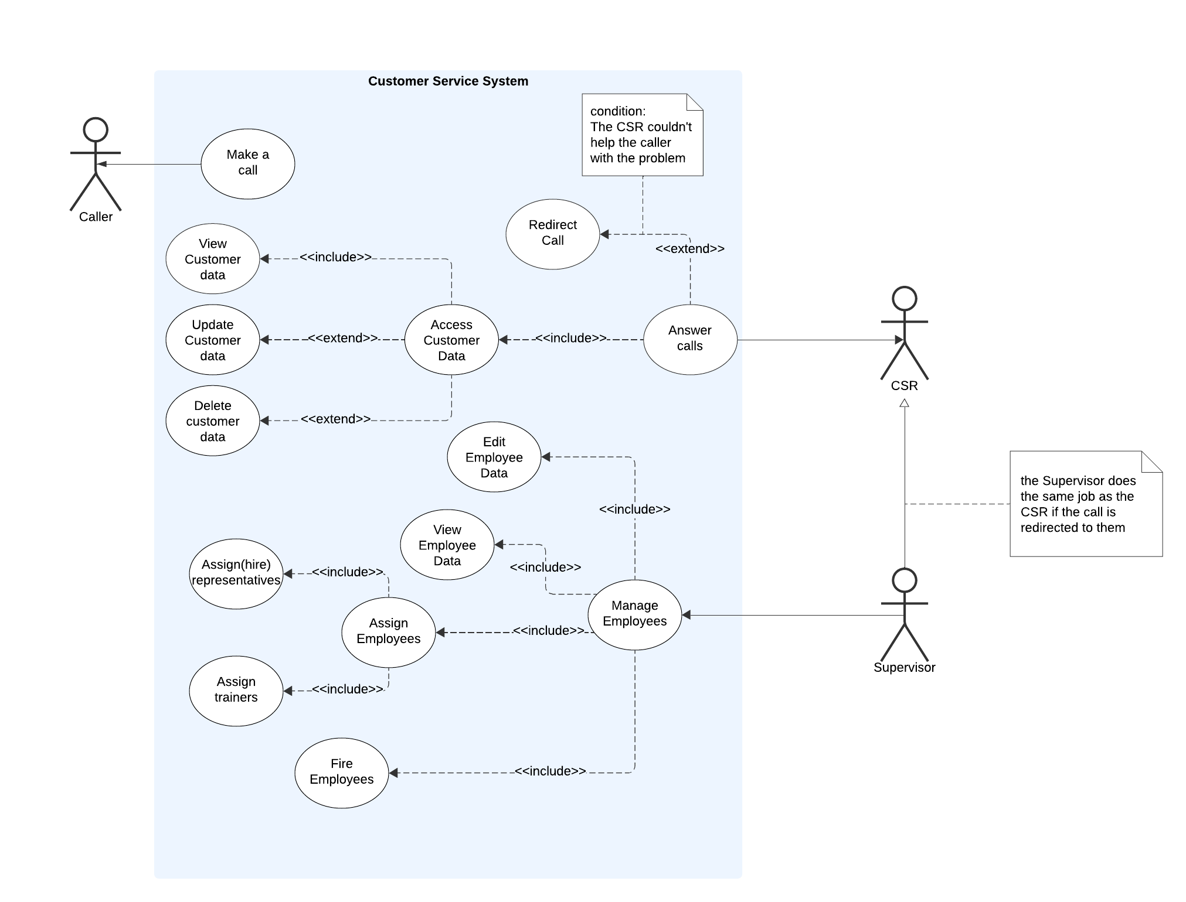
The use case diagram

Slide 11
Class diagram

Slide 12
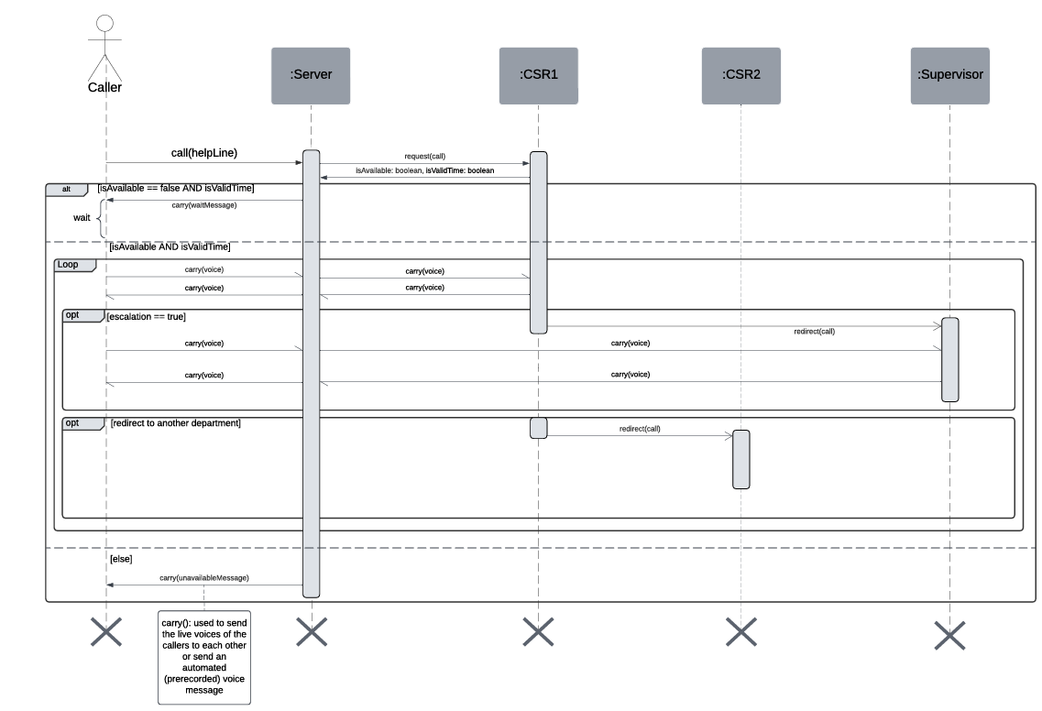
The caller’s sequence diagram

Slide 13
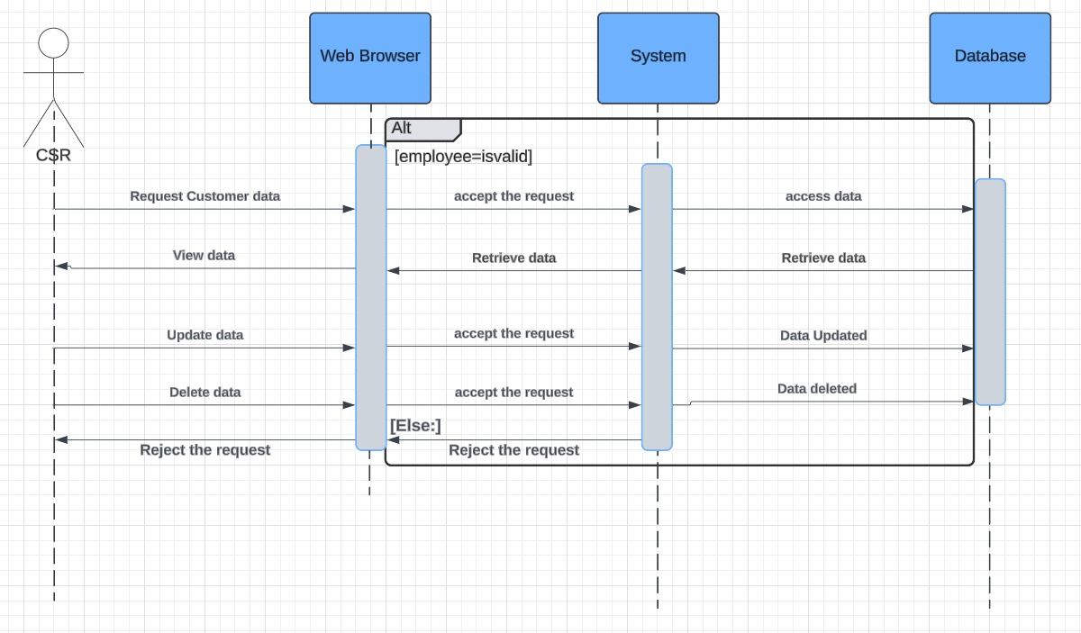
csr use case sequence diagram

Slide 14
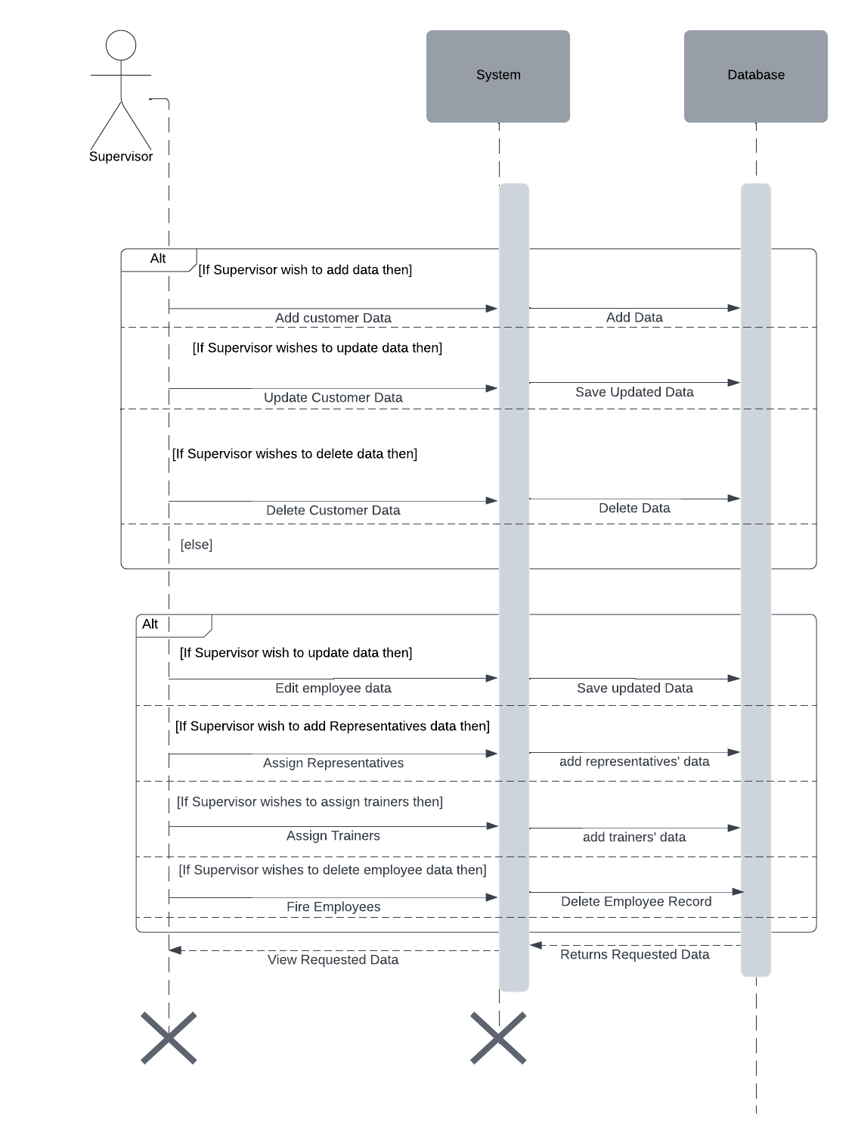
The supervisor sequence diagram

